Slide 1
Primality Testing

Slide 2
Fermat’s little theorem
If p is prime, then for every 1 ≤ a < p,
a^{p−1} ≡ 1 (mod p).
Proof of the Fermat’s little theorem:
Let S = {1, 2, . . . , p − 1}. We claim that
the effect of multiplying these numbers by a (modulo p) is simply to permute them.
Assume a · i ≡ a · j (mod p). Dividing both sides by a gives
i ≡ j (mod p).
They are nonzero because a · i ≡ 0 (mod p) similarly implies i ≡ 0 (mod p). (And we can divide by a, because by assumption it is nonzero and therefore relatively prime to p.)

Slide 3
Proof of the Fermat’s little theorem (cont’d)
We now have two ways to write set S:
S = {1, 2, . . . , p − 1} = {a · 1 mod p, a · 2 mod p, . . . , a · (p − 1) mod p} .
We can multiply together its elements in each of these representations to get
(p − 1)! ≡ a^{p−1} · (p − 1)! (mod p).
Dividing by (p − 1)! (which we can do because it is relatively prime to p, since p is assumed prime) then gives the theorem.

Slide 4
A (problematic) algorithm for testing primality
primality(N)
// Input: positive integer N
// Output: yes/no
Pick a positive integer a < N at random
if a^{N−1} ≡ 1 (mod N)
then return yes
else return no.
The problem is that Fermat’s theorem is not an if-and-only-if condition, e.g.,
341 = 11 · 31,
and 2³⁴⁰ ≡ 1 mod 341.
Our best hope: for composite N, most values of a will fail the test, which motivates the above algorithm: rather than fixing an arbitrary value of a in advance, we should choose it randomly from {1, . . . , N − 1}.

Slide 5
Carmichael numbers
Theorem
There are composite numbers N such that for every a < N relatively prime to N,
a^{N−1} ≡ 1 (mod N).
Example: 561 = 3 · 11 · 17.
Such composite numbers are called Carmichael numbers.

Slide 6
Non-Carmichael numbers
Lemma
If ^{N−1} /≡ 1 (mod N) for some a relatively prime to N, then it must hold for at least half the choices of a < N.
Proof.
Fix some value of a for which ^{N−1} /≡ 1 (mod N). Assume some b < N satisfies b^{N−1} ≡ 1 (mod N), then
(a · b)^{N−1} ≡ a^{N−1} · b^{N−1} ≡ a^{N−1} /≡ 1 (mod N).
For /≡ b^{l} (mod N) we have
a · b /≡ a · b^{l} (mod N).
The one-to-one function b → a · b mod N shows that at least as many elements fail the test as pass it.

Slide 7
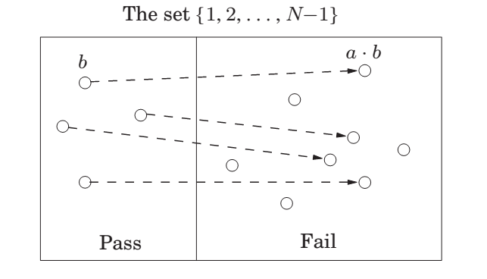

Slide 8
Primality testing without Carmichael numbers
We are ignoring Carmichael numbers, so we can now assert: If N is prime, then a^{N−1} ≡ 1 mod N for all a < N.
If N is not prime, then a^{N−1} ≡ 1 mod N
for at most half the values of a < N.
Therefore (for non-Carmichael numbers)
Pr(primality returns yes when N is prime) = 1
Pr(primality returns yes when N is not prime) ≤ ₂ .

Slide 9
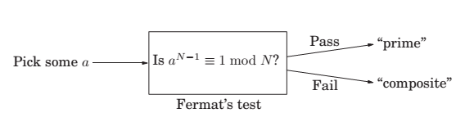
A “factorless” test for determining whether a Number N is prime

Slide 10
An algorithm for testing primality with low error probability
primality2(N)
// Input: positive integer N
// Output: yes/no
1. Pick positive integers a1 , a2 , . . . , ak < N at random 2.
3.
4.
N−1
if a ≡ 1 (mod N) for all i = 1, 2, . . . , k
i
then return yes
else return no.
Pr(primality2 returns yes when N is prime) = 1
Pr(primality2 returns yes when N is not prime) ≤ _{2k} .

Slide 11
Generating random primes
Lagrange’s prime number theorem. Let π(x be the number of primes ≤ x . Then (x ≈ x/(ln x), or more precisely
π(x )
lim = 1.
x →∞ (x/ ln x )
Such abundance makes it simple to generate a random n-bit prime:
Pick a random n-bit number N.
Run a primality test on N.
If it passes the test, output N; else repeat the process.

Slide 12
Generating random primes (cont’d)
Question
How fast is this algorithm?
If the randomly chosen N is truly prime, which happens with probability at least 1/n, then it will certainly pass the test. So on each iteration, this procedure has at least a 1/n chance of halting.
Therefore on average it will halt within O(n) rounds.

Slide 13
Cryptography

Slide 14
The typical setting for cryptography
. Alice and Bob, who wish to communicate in private.
Eve, an eavesdropper, will go to great lengths to find out what Alice and Bob are saying.
Alice wants to send a specific message x , written in binary, to her friend Bob.
Alice encodes it as e(x), sends it over.
Bob applies his decryption function d (·) to decode it: d (e(x)) = x .
Eve, will intercept e(x ): for instance, she might be a sniffer on the network.

Slide 15
Ideally the encryption function e(·) is so chosen that without knowing d (·), Eve cannot do anything with the information she has picked up.
In other words, knowing e(x) tells her little or nothing about what x might be.
An encryption function:
e : (messages〉 → (encoded messages〉.
e must be invertible – for decoding to be possible – and is therefore a bijection. Its inverse is the decryption function d (·).

Slide 16
Private-key schemes: one-time pad
.., Alice and Bob meet beforehand and secretly choose a binary string r of the same length–say, n bits–as the important message x that Alice will later send.
.. Alice’s encryption function is then a bitwise exclusive-or,
er (x ) = x ⊕ r .
.., This function er is a bijection from n-bit strings to n-bit strings, as it is its own inverse:
er (er (x )) = (x ⊕ r) ⊕ r = x ⊕ (r ⊕ r) = x ⊕ = x.
So Bob chooses the decryption function dr (y ) = y ⊕ r .

Slide 17
One-time pad (cont’d)
How should Alice and Bob choose r for this scheme to be secure?
They should pick r at random, flipping a coin for each bit, so that the resulting string is equally likely to be any element of {0, 1}^{n} .
This will ensure that if Eve intercepts the encoded message y = e_{r} (x), She get no information about x : all r ’s are equally possible, thus all possibilities for x are equally likely!

Slide 18
The downside of one-time pad
The downside of the one-time pad is that it has to be discarded after use, hence the name.
A second message encoded with the same pad would not be secure, because if Eve knew x ⊕ r and z ⊕ r for two messages x and z , then she could take the exclusive-or to get x ⊕ z , which might be important information:
it reveals whether the two messages begin or end the same;
if one message contains a long sequence of zeros (as could easily be the case if the message is an image), then the corresponding part of the other message will be exposed.

Slide 19
Problems with symmetric key
Therefore the random string that Alice and Bob share has to be the combined length of all the messages they will need to exchange.
Random strings are costly!
Question: How do you deliver the secrete key?
Answer: Using unsymmetrical key!

Slide 20
The Rivest-Shamir-Adelman (RSA) cryptosystem
An example of public-key cryptography:
Anybody can send a message to anybody else using publicly available information, rather like addresses or phone numbers.
Each person has a public key known to the whole world and a secret key known only to him- or herself.
When Alice wants to send message x to Bob, she encodes it using his public key.
Bob decrypts it using his secret key, to retrieve x .
Eve is welcome to see as many encrypted messages for Bob as she likes, but she will not be able to decode them, under certain simple assumptions.

Slide 21
Property
Pick any two primes p and q and let N = pq. For any e relatively prime to (p − 1)(q − 1):
The mapping x 1→ x^{e} mod N is a bijection on {0, 1, . . . , N − 1}.
The inverse mapping is easily realized: let d be the inverse of e modulo (p − 1)(q − 1). Then for all x ∈ {0, 1, . . . , N − 1},
(x^{e} )^{d} ≡ x (mod N).
.., The mapping x 1→ x mod N is a reasonable way to encode messages x ; no information is lost. So, if Bob publishes (N, e) as his public key, everyone else can use it to send him encrypted messages.
.., Bob should retain the value d as his secret key, with which he can decode all messages that come to him by simply raising them to the d th power modulo N.

Slide 22
Proof of the property
If the mapping x 1→ x^{e} mod N is invertible, it must be a bijection; hence statement 2 implies statement 1.
To prove statement 2, we start by observing that e is invertible modulo
(p − 1)(q − 1) because it is relatively prime to this number. It remains to show that
(x^{e} )^{d} ≡ x mod N.
Since ed ≡ 1 mod (p − 1)(q − 1), we can write
ed = 1 + k(p − 1)(q − 1)
for some k. Then
_{(x}e ₎d _{− x = x}ed _{− x = x} 1+k(p−1)(q−1) _{− x.}
x ^{1+k(p−1)(q−1)} − x is divisible by p (since x^{p−1} ≡ 1 (mod p)) and likewise by q.
Since p and q are primes, this expression must be divisible by N = pq.

Slide 23
RSA protocol
Bob chooses his public and secret keys:
He starts by picking two large (n-bit) random primes p and q.
His public key is (N, e) where N = pq and e is a 2n-bit number relatively prime to (p − 1)(q − 1). A common choice is e = 3 because it permits fast encoding.
His secret key is d , the inverse of e modulo (p − 1)(q − 1), computed using the extended Euclid algorithm.
Alice wishes to send message x to Bob:
She looks up his public key (N, e) and sends him y = (x^{e} mod N), computed using an efficient modular exponentiation algorithm.
He decodes the message by computing y^{d} mod N.

Slide 24
Security assumption for RSA
The security of RSA hinges upon a simple assumption:
Given N, e, and y = x^{e} mod N, it is computationally intractable to determine x.
How might Eve try to guess x ? She could experiment with all possible values of x , each time checking whether x^{e} ≡ y mod N, but this would take exponential time.
Or she could try to factor N to retrieve p and q, and then figure out d by inverting e modulo (p − 1)(q − 1), but we believe factoring to be hard.

Slide 25
Universal Hashing

Slide 26
Motivation
We will give a short “nickname” to each of the 2³² possible IP addresses.
You can think of this short name as just a number between 1 and 250 (we will later adjust this range very slightly).
Thus many IP addresses will inevitably have the same nickname; however, we hope that most of the 250 IP addresses of our particular customers are assigned distinct names, and we will store their records in an array of size 250 indexed by these names.

Slide 27
Motivation, cont.
What if there is more than one record associated with the same name?
Easy: each entry of the array points to a linked list containing all records with that name. So the total amount of storage is proportional to 250, the number of customers, and is independent of the total number of possible IP addresses.
Moreover, if not too many customer IP addresses are assigned the same name, lookup is fast, because the average size of the linked list we have to scan through is small.

Slide 28
Hash tables
How do we assign a short name to each IP address?
This is the role of a hash function: A function h that maps IP addresses to positions in a table of length about 250 (the expected number of data items).
The name assigned to an IP address x is thus h(x), and the record for x is stored in position h(x) of the table.
Each position of the table is in fact a bucket, a linked list that contains all current IP addresses that map to it.
Hopefully, there will be very few buckets that contain more than a handful of IP addresses.

Slide 29
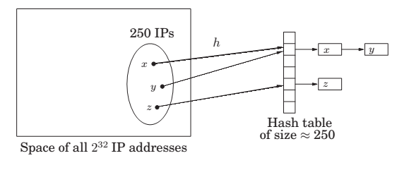
Hash Mapping

Slide 30
How to choose a hash function?
In our example, one possible hash function would map an IP address to the 8-bit number that is its last segment:
h(128.32.168.80) = 80.
A table of n = 256 buckets would then be required.
But is this a good hash function?
Not if, for example, the last segment of an IP address tends to be a small (single- or double-digit) number; then low-numbered buckets would be crowded.
Taking the first segment of the IP address also invites disaster, for example, if most of our customers come from Asia.

Slide 31
How to choose a hash function? (cont’d)
There is nothing inherently wrong with these two functions. If our 250 IP addresses were uniformly drawn from among all N = 2³² possibilities, then these functions would behave well.
The problem is we have no guarantee that the distribution of IP addresses is uniform.
Conversely, there is no single hash function, no matter how sophisticated, that behaves well on all sets of data.
Since a hash function maps 2³² IP addresses to just 250 names, there must be a collection of at least
2³² /250 ≈ 2²⁴ ≈ 16, 000, 000
IP addresses that are assigned the same name (or, in hashing terminology, collide).
Solution: let us pick a hash function at random from some class of functions.

Slide 32
Families of hash functions
Let us take the number of buckets to be not 250 but n = 257. a prime number!
We consider every IP address x as a quadruple x = (x₁ , x₂ , x₃ , x₄)
of integers modulo n.
We can define a function h from IP addresses to a number mod n as follows:
Fix any four numbers mod n = 257, say 87, 23, 125, and 4. Now map the IP address x = (x₁ , . . . , x₄) to h(x₁ , . . . , x₄) = (87x₁ + 23x₂ + 125x₃ + 4x₄) mod 257.
In general for any four coefficients a₁ , a₂ , a₃ , a₄ ∈ {0, 1, . . . , n − 1} write a = (a₁ , a₂ , a₃ , a₄) and define h_{a} to be the following hash function:
h_{a} (x₁ , . . . , x₄) = (a₁ · x₁ + a₂ · x₂ + a₃ · x₃ + a₄ · x₄) mod n.

Slide 33
Property
Consider any pair of distinct IP addresses x = (x₁ , . . . , x₄) and y = (y₁ , . . . , y₄). If the coefficients a = (a₁ , . . . , a₄) are chosen uniformly at random from{0, 1, . . . , n − 1}, then
.
Pr [ha (x1 , . . . , x4) = ha (y1 , . . . , y4)] =
n

Slide 34
Universal families of hash functions
Let
H = {ha | a ∈ {0, 1, . . . , n − 1}⁴}.
It is universal:
For any two distinct data items x and y, exactly |H|/n of all the hash functions in H map x and y to the same bucket, where n is the number of buckets.

Slide 35
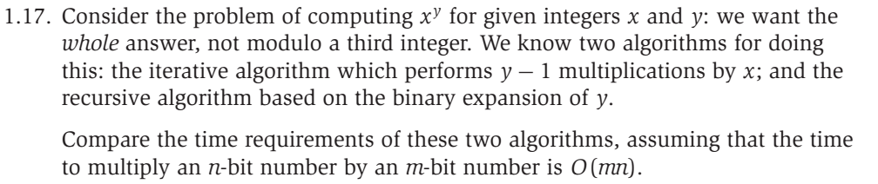
Excise 2

Slide 36
Excise 3

